Slide 1



Form Matters Team: Heroes. Offering. Electronic. Solutions.

Slide 2





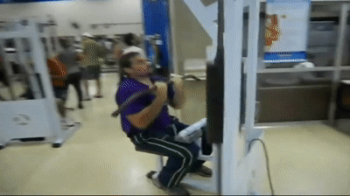




Why FormMatters
Improper form can lead to life-long painful injuries.
There are thousands of different resources with different information on how you should be active.
We wanted to personalize that experience in an all-in-one app.

Slide 3




How we did it:

Slide 4
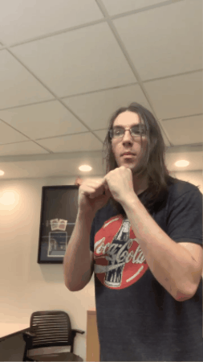
Demo Time

Slide 5
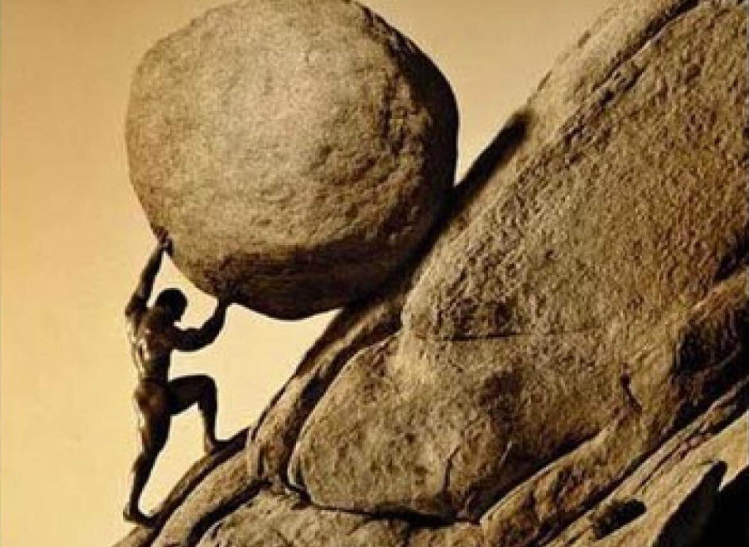

Challenges We Faced
React Native and Android Studio - Fails
Getting model predictions to show – took almost the entire hackathon to implement
We built our website from scratch starting at noon today, we wanted to implement more features.

